Slide 1

“MONEY TRANSFER”
Task - 2

Slide 2

GroceryꢀDeliveryꢀWebsite
▪
Creating frontend for grocery delivery
service using html and css
LMS Username
2108a33288
2108a33290
2108a33292
2108a33304
Name
NIROSHA.R
PRADEEP.M
RUBINI.P.V
Batch
A33
A33
A33
VASUMATHI.V
A33

Slide 3

Taskꢀ-ꢀ2
CreateꢀvariousꢀFrontꢀEndꢀPrograms
•ꢀꢀꢀꢀꢀDrawꢀandꢀdesignꢀaꢀuniformꢀfrontꢀendꢀcodeꢀforꢀ“Groceryꢀ
DeliveryꢀWebsite”
•ꢀꢀꢀDrawꢀandꢀdesignꢀaꢀinteractiveꢀfrontꢀendꢀcodeꢀforꢀꢀꢀꢀꢀ
“GroceryꢀDeliveryꢀWebsite”
EvaluationꢀMetric:
● 100%ꢀCompletionꢀofꢀtheꢀaboveꢀtasks
Learning Outcome
▪
▪
▪
▪
DevelopingꢀcomplicatedꢀUIꢀusingꢀꢀHTMLꢀcomponents
Usingꢀpropsꢀdrillingꢀandꢀcontextꢀtoꢀpassꢀvariables
Gettingꢀꢀfamiliarꢀorꢀwithꢀdifferentꢀtypeꢀofꢀapiꢀcalls
Handlingꢀdifferentꢀinputꢀdata

Slide 4

MONEY TRANSFER
INTRODUCTION:-
Money transfer generally refers to one of
the following cashless modes of payment or
payment systems: Electronic funds transfer,
an umbrella term mostly used for bank card
-based payments. Wire transfer, an
international expedited bank-to-bank funds
transfer. Giro (banking), also known as
direct deposit.

Slide 5
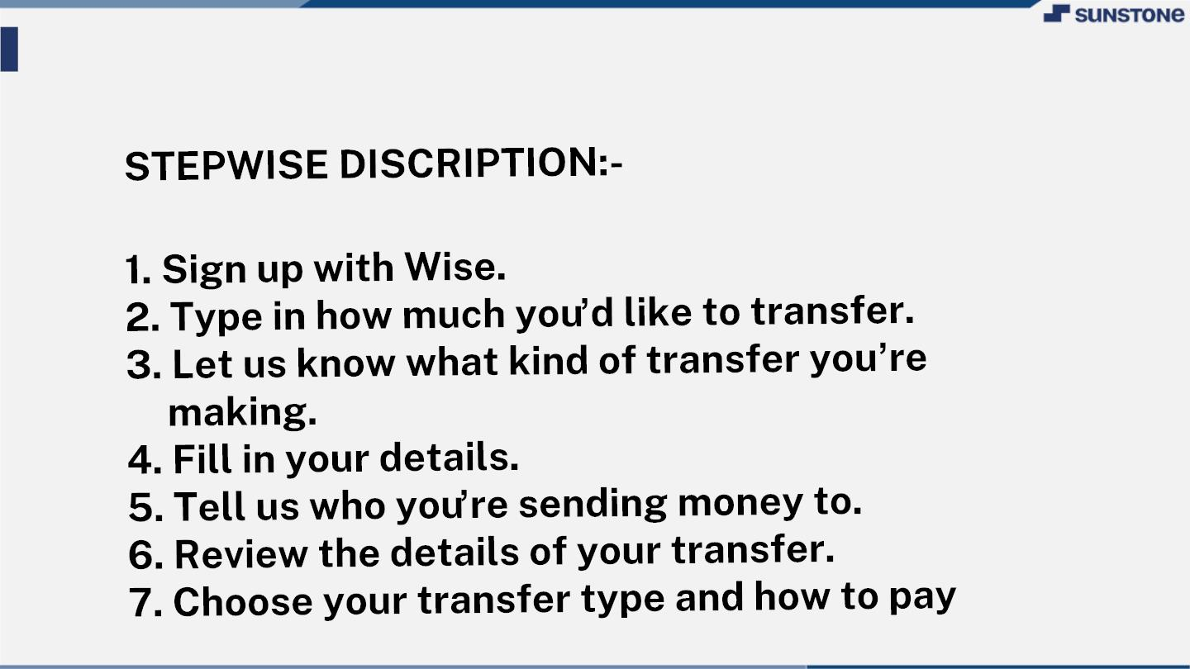
MONEY TRANSFER:-

Slide 6

MONEY TRANSFER:-
▪ System Overview:
▪
Money transfer generally refers to one of
the following cashless modes of payment or
payment systems:
▪
▪
Electronic funds transfer, an umbrella term
mostly used for bank card-based payments
Wire transfer, an international expedited
bank-to-bank funds transfer
▪
▪
Giro (banking), also known as direct deposit
Money order, transfer by postal cheque,
money gram or others
▪
Postal order, purchased at a post office and
is payable at another post office to the
named recipient

Slide 7
MONEY TRANSFER:-
SUMMARY
▪
A Funds Transfer is a sequence of
events that results in the movement
of funds from the remitter to the
beneficiary. It is also defined as the
remittance of funds from one party to
itself or to another party through the
banking system.

Slide 8

AssessmentꢀParameter
SetupꢀProjectꢀforꢀCalculatorꢀ
project
Setupꢀbasicꢀstructureꢀofꢀtext-
editorꢀproject
Createꢀaꢀmainꢀcomponentꢀwithꢀtheꢀ
outerꢀstructureꢀofꢀcalculator
Check-List
Createꢀmainꢀcomponentꢀwithꢀ
allꢀfeatureꢀbuttons
Createꢀaꢀbuttonꢀcomponentꢀ
withꢀonꢀclickꢀhandler
Createꢀaꢀjsonꢀobjectꢀtoꢀstoreꢀ
dataꢀforꢀtextꢀeditor
Createꢀaꢀ`ꢀevaluateExpresion`ꢀ
functionꢀtoꢀevaluateꢀvalue
Pushꢀbothꢀcodeꢀtoꢀgithub

Slide 9

Submission Github
https://github.com/Rubinimoni/g
roupꢀ13ꢀA33

Slide 10


